Slide 2
Securing the Superpowers -
Who loaded that eBPF program?
John Fastabend, Natalia Reka Ivanko
Notes:
Welcome everyone!

Slide 3




Would just ad
Speakers
John Fastabend
Tetragon Lead & Cilium Maintainer, Engineer
Isovalent
Natalia Reka Ivanko
Security Product Lead
Isovalent
Notes:
Who is speaking today?

Slide 4
eBPF is on the rise
Notes:
I wanted to start with a background, motivation to this talk first.
As you already know eBPF is on the rise - already rose. Became one of the leading Linux kernel technology today.

Slide 5



Motivation
Networking
Observability
Security
High Performance
Load Balancing
Application tracing
Performance troubleshooting
Performance monitoring
Detect suspicious behaviour
Least privileged policies
Preventative Security
Notes:
More and more projects are using it under the hood for different use cases in networking, observability, security.
Small subset of projects that are using eBPF but would give you a glimpse of what can be done in different areas.
Networking:
High performance, load balancing
Modern data centers & cloud native env
Katran: high performance LB from Facebook that they created to replace IPVS (other software based LB solution)
Switched to eBPF => saw massive performance increase
OSS => check out the repo (FB specific but good for other linux based soft. Infr. systems)
Cilium:
providing networking, LB, security for K8s services
Observability:
Bcc, bpftrace:
Application profiling and tracing
Understanding what my application is doing? Why my application is not behaving the way we expect? How many block IO calls it’s making etc.
Hubble:
Visibility component of Cilium
Network Policy troubleshooting/audit for K8s services. Which network flows are allowed or denied by which network policy? What is the source pod etc?
Security:
We’ll deep dive into these use cases later
Tetragon, Falco, Tracee, Inspektor Gadget. Applying BPF for container runtime security
Inspecting kernel functions, system calls and figuring out if a malicious behaviour has happened
implement least privileged policies based on the observed events => we can create profiles which describes what the application should be doing and preventing everything else
BPF for preventative security => terminate on any kernel function or system call inside the kernel instead of having a userspace agent which would report it.

Slide 6
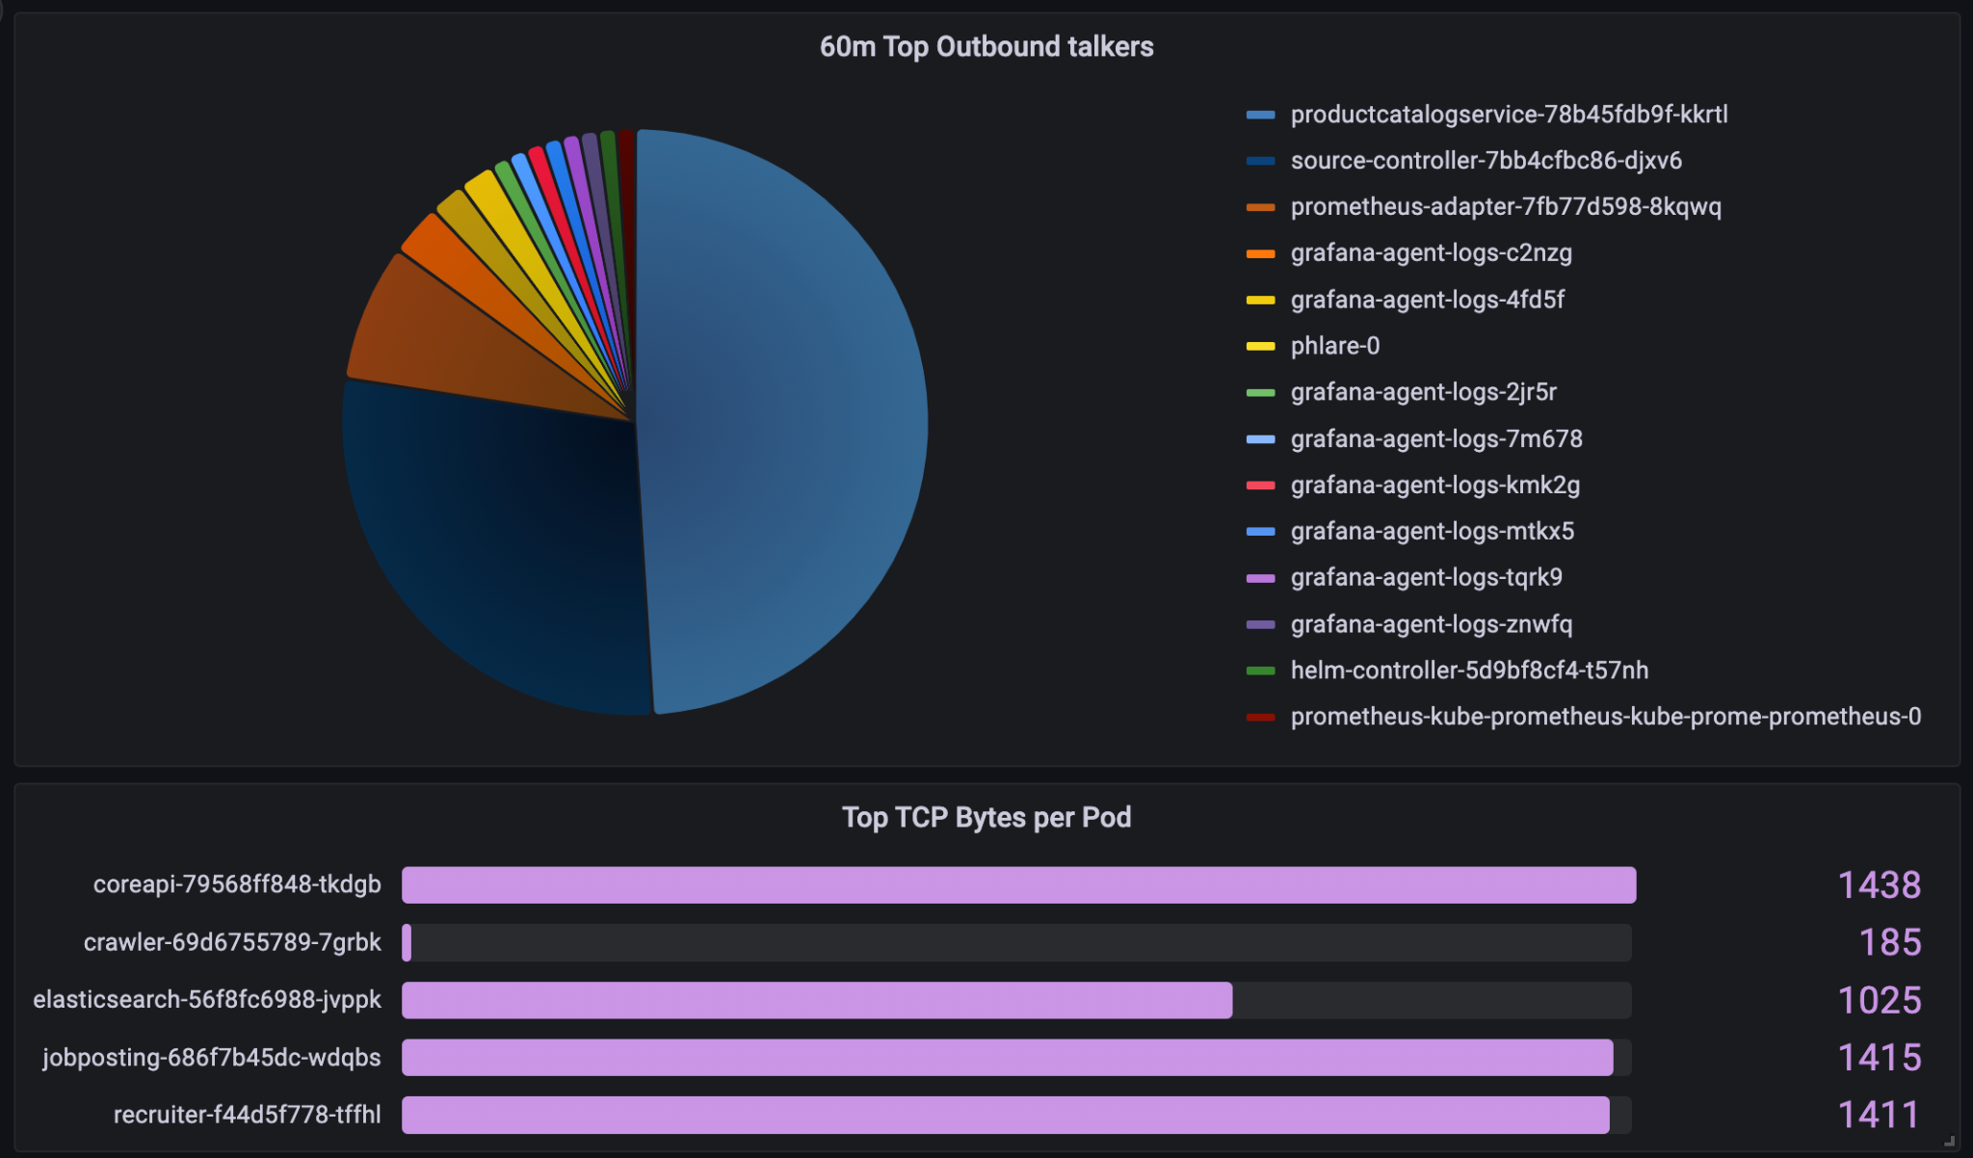
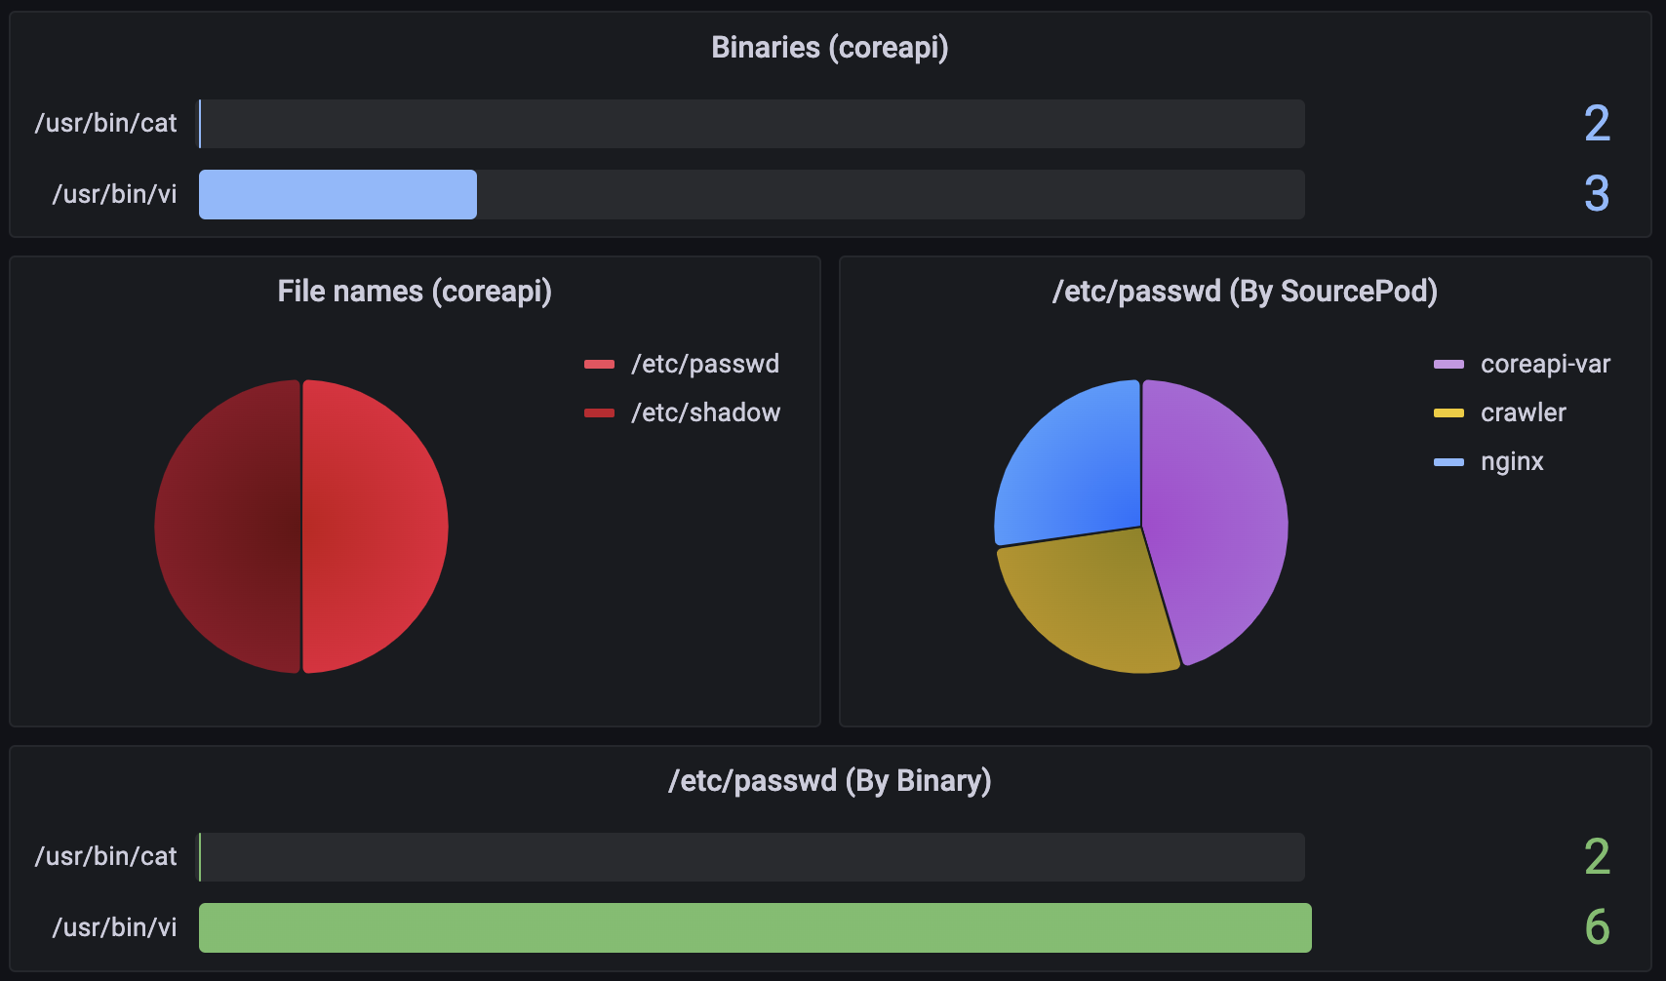
Security Use Cases
File Integrity Monitoring
Data Exfiltration
Notes:
Data Exfiltration:
Security Teams can observe a Kubernetes namespace and figure out:
which pods were the most outbound talkers in the last hour?
Is it expected?
Who sent out the most traffic? Can it be data exfiltration?
File Integrity Monitoring:
Which workloads opened sensitive files on a certain namespace?
With which binaries?
Who was root when doing that?
Is it even expected?

Slide 7
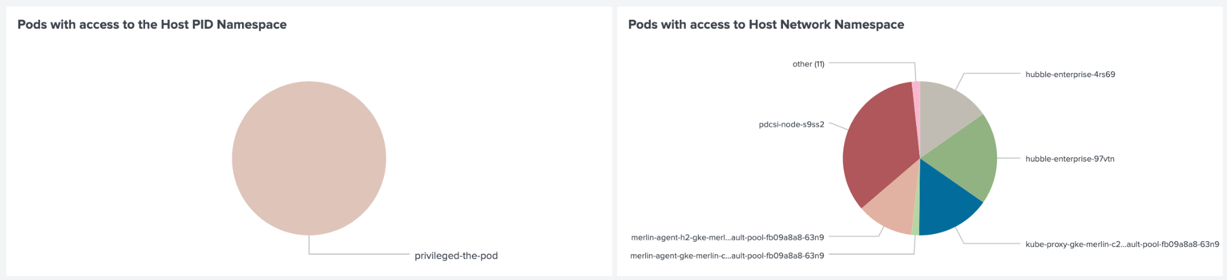
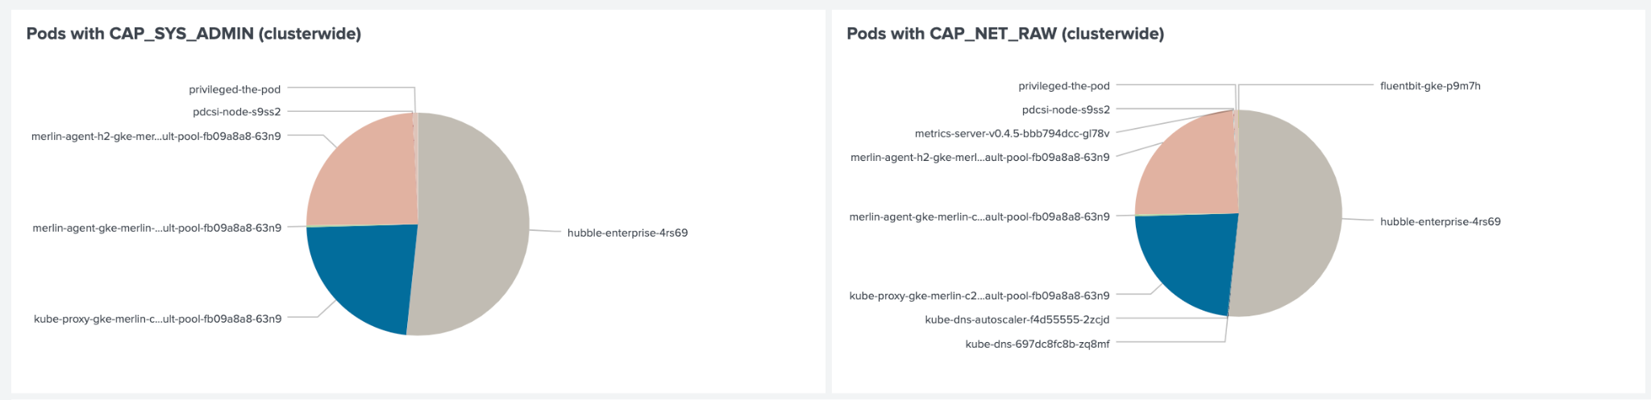
Security Use Cases
Namespace Access
Capability Abuse
Notes:
Capability and namespace access.
Security Teams can monitor a certain namespace and ask questions:
Which pods were running with CAP_SYS_ADMIN on my cluster? With CAP_NET_RAW?
Do we expect this?
Which pod has access to the host PID or network namespace in my cluster?
Do we expect this?
How long? Who started these pods?
These are just a small subset of use cases eBPF can bring to Security.

Slide 8
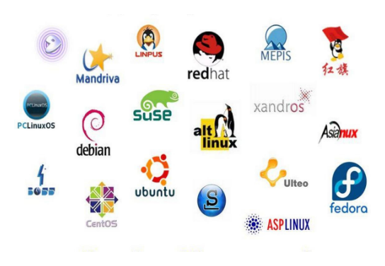
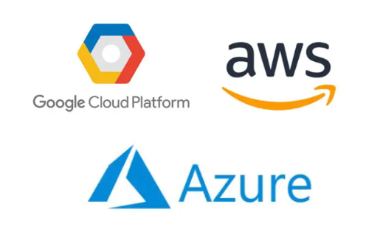

eBPF became cross platform
Windows Runtime recently
Most Linux distributions
Cloud providers
Notes:
eBPF became cross platform.
It can run on Windows machine with the Windows Runtime recently
It’s available on most Linux distributions
The 3 major cloud providers also support it: GCP, AWS and Azure.

Slide 9
Motivation
Since eBPF became so powerful, Security Teams need to answer questions like:
Who is watching eBPF?
To remain secure it’s really important to keep track and audit:
what BPF programs were loaded
what BPF maps were created

Slide 10
Auditing BPF programs
What does audit mean?
Who loaded it?
Which Kubernetes workload, which process, which binary, from which ancestors?
When was it loaded?
Should this program be expected?
Have we seen this program or the process before?
Should the process touch bpf() at all?

Slide 11
Auditing BPF programs with Tetragon

Slide 12
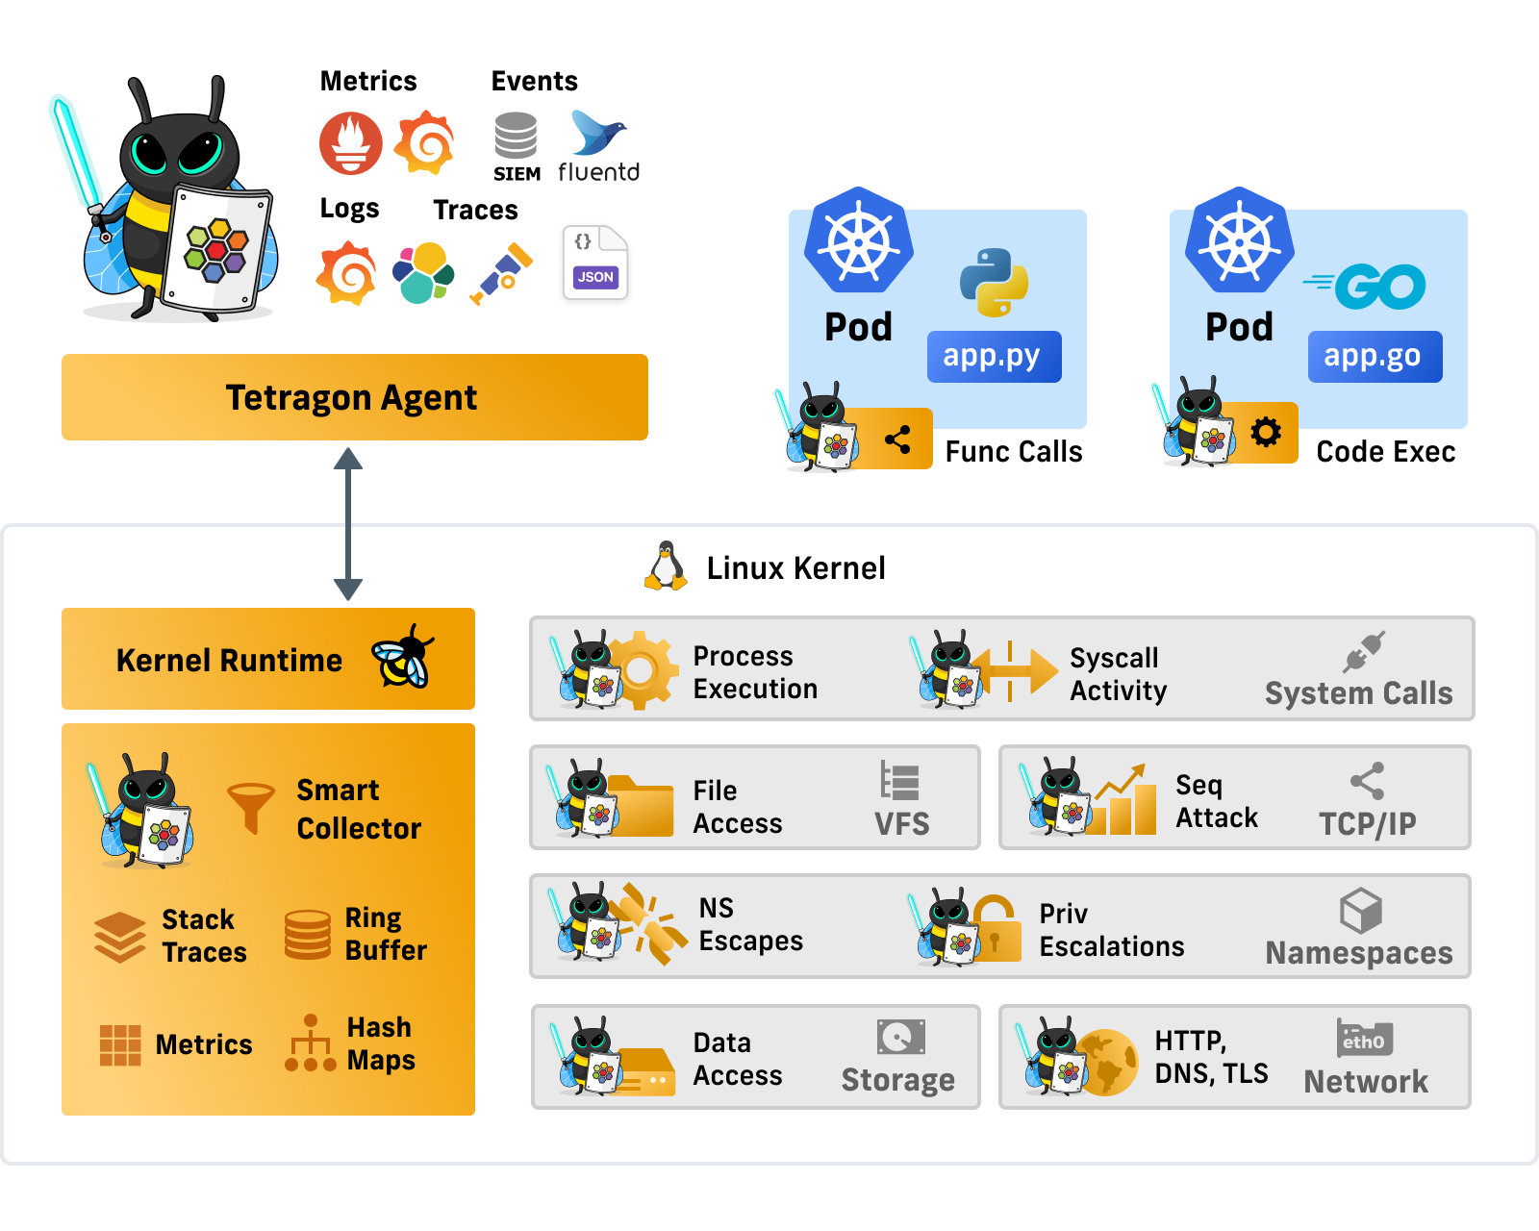
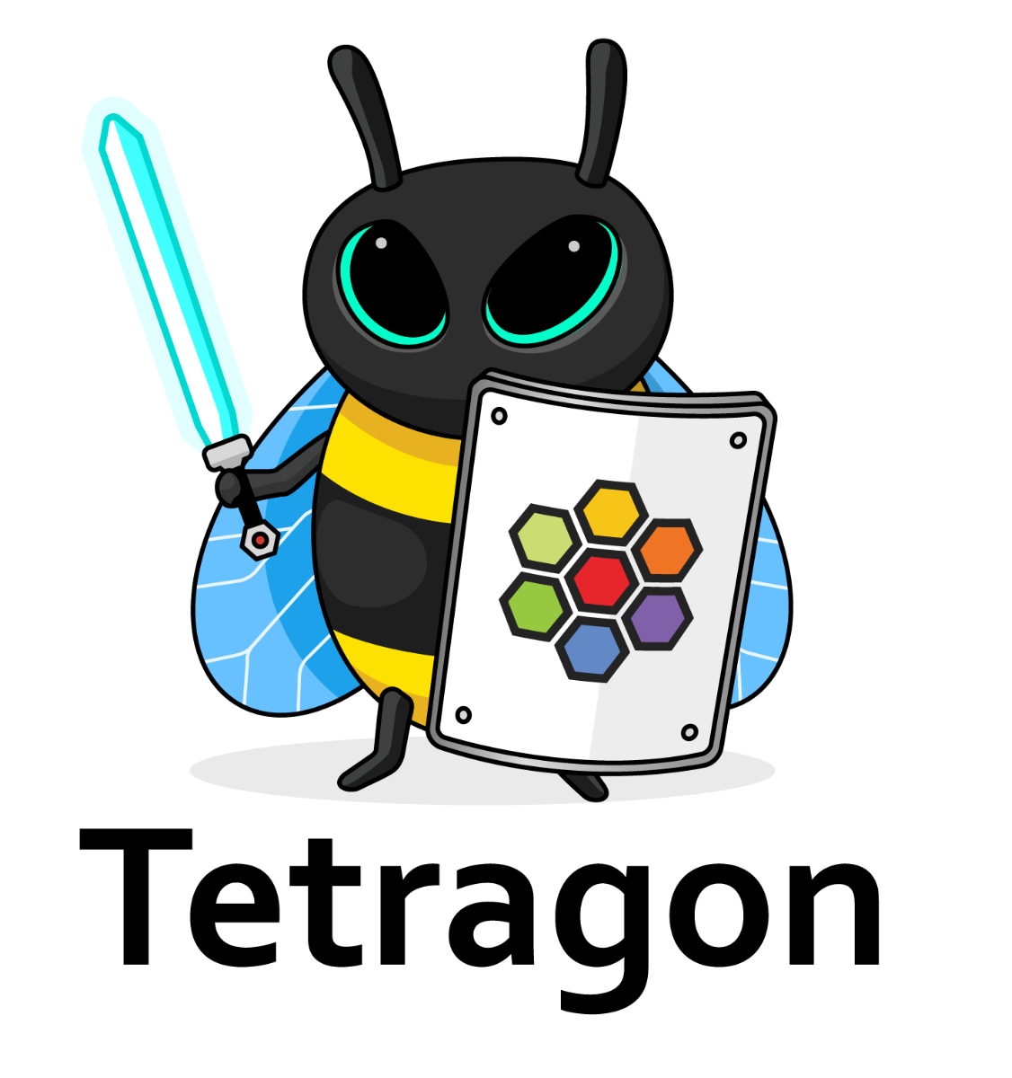
Security Observability & Runtime Enforcement
Notes:
Tetragon is an agent.
It can run on top of any Linux OS system.
In case of Kubernetes, cloud native environment: daemonset
In case of bare metal, VMs: container that mounts certain configuration files as volumes.
It uses eBPF to extract Security Observability data + provide Runtime Enforcement.
There are a lot of layers where Tetragon can extract data from and provide enforcement. Starting from the low level: Data Access, File Access
Network: with a variety of parsers including L7 parsers (HTTP, DNS, TLS) and L3/L4: TCP, UDP.
Namespacing/namespace technology in the kernel (whether it can be network, pid, mount, utc etc) as well as capabilities, privilege access.
Process execution layer, where we can observe system call (and any kernel function) activity.
Very important: Tetragon is transparent, doesn’t require any application or code change.
All the Observability Data that we extract (JSON events) can be extracted to a log file and be integrated with many system listed above. SIEM: Elasticsearch, Splunk, SumoLogic, S3. => for this we use fluentd as a sidecar. So any plugin is supported that fluentd supports. But if you have your own log shipping system in place already we can integrate with that too. All the Security relevant use cases typically goes here.
Metrics: Prometheus, Grafana as well as OpenTelemetry. These are the Networking use cases mostly.
Tetragon is part of the Cilium family but it can run on its own, doesn’t require Cilium to run.

Slide 13
Tetragon - Auditing eBPF programs
What is a BPF Program
A Running BPF Program:
Set of BPF instructions
CO-RE
Set of Maps
Set of Syscalls
BPF program Type
BPF Attach location
The BPF Filesystem (Lifetime management)
/sys/fs/bpf/<programs | maps>
/sys/fs/bpf/tetragon/link
BPF
Program
insn
maps
syscalls
type
attached

Slide 14
Tetragon - Auditing eBPF programs
BPF CO-RE
Kernel
BTF
Core networking
BPF application
BPF
loader
tc
BPF verifier
XDP (& AF_XDP)
BPF program
BPF bytecode
BPF compiler
sock_addr/sk
BPF JIT
BPF [runtime]
reuseport
User, program data
Shared BPF
maps
sk_lookup
Per-event data
BPF ringbuf
Congestion control
Statistics, stacks
perf buffer
struct_ops
Misc
L7 observability & Policy, IPC
iterators
Hardening
sockmap
[ modified from Gregg, BPF Internals, LISA’21 ]
freplace
flow dissector

Slide 15
Tetragon - Auditing eBPF programs
BPF CO-RE
Kernel
BTF
Core networking
BPF application
BPF
loader
tc
BPF verifier
XDP (& AF_XDP)
BPF program
BPF bytecode
BPF compiler
sock_addr/sk
BPF JIT
BPF [runtime]
reuseport
User, program data
Shared BPF
maps
sk_lookup
Per-event data
BPF ringbuf
Congestion control
Statistics, stacks
perf buffer
struct_ops
Misc
L7 observability & Policy, IPC
iterators
Hardening
sockmap
[ modified from Gregg, BPF Internals, LISA’21 ]
freplace
flow dissector

Slide 16
Tetragon - Auditing eBPF programs
Case A
Alice (0xfoo)
MapA
MapB
__sys_bpf(load)
Alice.o
bpf_load bpf-ns/alice /usr/bin/alice [sha256]
BPF_PROG_TYPE_KPROBE alice_func instruction count 2
bpf_map_alloc bpf-ns/alice /usr/bin/alice [sha256]
BPF_MAP_TYPE_HASH MapA key size 4 value size 20 max entries 4
[1] You and Your Security Profiles; Generating Security Policies with the Help of eBPF - John Fastabend & Natalia Reka Ivanko, Isovalent ]

Slide 17
Tetragon - Auditing eBPF programs
Case Analysis
Alice (0xfoo)
Eve (0x0bad)
Bob (0xbar)
Eve.o
MapA
MapX
MapB
MapY
__sys_bpf(load)
Alice.o
Bob.o

Slide 18
Tetragon - Auditing eBPF programs
Case Analysis
Alice (0xfoo)
Eve (0x0bad)
Bob (0xbar)
Eve.o
MapA
MapX
MapB
MapY
__sys_bpf(load)
Alice.o
Bob.o
bpf_load bpf-ns/eve /usr/bin/eve [sha256]
BPF_PROG_TYPE_KPROBE alice_func instruction count 2
bpf_load bpf-ns/alice /usr/bin/eve [sha256]
BPF_PROG_TYPE_KPROBE alice_func instruction count 2

Slide 19
Tetragon - Auditing eBPF programs
Case Analysis
Alice (0xfoo)
Eve (0x0bad)
Bob (0xbar)
Eve.o
MapA
MapX
MapB
MapY
__sys_bpf(load)
Alice.o
Bob.o
bpf_load bpf-ns/eve /usr/bin/eve [sha256]
BPF_PROG_TYPE_KPROBE alice_func instruction count 2
bpf-ns/alice: CAP_BPF
bpf-ns/eve: ~CAP_BPF
bpf_load bpf-ns/alice /usr/bin/eve [sha256]
BPF_PROG_TYPE_KPROBE alice_func instruction count 2

Slide 20
Tetragon - Auditing eBPF programs
Case Analysis
kind: TracingPolicy
metadata:
name: "bpf"
spec:
kprobes:
- call: "bpf_check"
syscall: false
selectors:
- matchBinarys:
- operator: NotEqual
values:
- “/usr/bin/Alice”^{[1]}
matchActions:
- action: Sigkill
Alice (0xfoo)
Eve (0x0bad)
Eve.o
MapA
MapB
__sys_bpf(load)
Alice.o
bpf_load bpf-ns/eve /usr/bin/eve [sha256]
BPF_PROG_TYPE_KPROBE alice_func instruction count 2
bpf_load bpf-ns/alice /usr/bin/eve [sha256]
BPF_PROG_TYPE_KPROBE alice_func instruction count 2
[1] You and Your Security Profiles; Generating Security Policies with the Help of eBPF - John Fastabend & Natalia Reka Ivanko, Isovalent ]

Slide 21
Tetragon - Auditing eBPF programs
Case Analysis
kind: TracingPolicy
metadata:
name: "bpf"
spec:
kprobes:
- call: "bpf_check"
syscall: false
selectors:
- matchSha256:
- operator: NotEqual
values:
- “0xf00”^{[1]}
matchActions:
- action: Sigkill
Alice (0xfoo)
Eve (0x0bad)
Eve.o
MapA
MapB
__sys_bpf(load)
Alice.o
bpf_load bpf-ns/eve /usr/bin/eve [sha256]
BPF_PROG_TYPE_KPROBE alice_func instruction count 2
bpf_load bpf-ns/alice /usr/bin/eve [sha256]
BPF_PROG_TYPE_KPROBE alice_func instruction count 2
[1] You and Your Security Profiles; Generating Security Policies with the Help of eBPF - John Fastabend & Natalia Reka Ivanko, Isovalent ]

Slide 22
Tetragon - Auditing eBPF programs
Alice (0xfoo)
Eve (0x0bad)
Bob (0xbar)
Eve.o
MapA
MapX
MapB
MapY
__sys_bpf(load)
Alice.o
Bob.o
Linux mount and file systems
File Integrity Monitoring through Tetragon or otherwise.

Slide 23
Tetragon - Auditing eBPF programs
Alice (0xfoo)
Eve (0x0bad)
Bob (0xbar)
Eve.o
MapA
MapX
MapB
MapY
__sys_bpf(load)
Alice.o
Bob.o
- call: "bpf_check"
syscall: false
selectors:
- matchBinarys:
- operator: NotEqual
values:
- “/usr/bin/Alice”^{[1]}
Bob has permissions to Load BPF programs

Slide 24
Tetragon - Auditing eBPF programs
Alice (0xfoo)
Eve (0x0bad)
Bob (0xbar)
Eve.o
MapA
MapX
MapB
MapY
__sys_bpf(load)
Alice.o
Bob.o
Bob has permissions to Load BPF programs
Bob only reads/writes/creates maps Bob has FIM and BPF access to
Bob launches with validated SHA256
Bob is corrupted at runtime and loads unvalidated instructions

Slide 25
Tetragon - Auditing eBPF programs
Alice (0xfoo)
Eve (0x0bad)
Bob (0xbar)
Eve.o
MapA
MapX
MapB
MapY
__sys_bpf(load)
Alice.o
Bob.o
Bob has permissions to Load BPF programs
Bob only reads/writes/creates maps Bob has FIM and BPF access to
Bob launches with validated SHA256
Bob is corrupted at runtime and loads unvalidated instructions WIP: hash of the instructions loaded (can be complicated) and/or log of instructions

Slide 26
Tetragon - Auditing eBPF programs
Summary
Alice (0xfoo)
Eve (0x0bad)
Bob (0xbar)
Eve.o
MapA
MapX
MapB
MapY
Alice.o
Bob.o
Alice loads program
Eve loads 0xbad program
Eve/Bob read/write/create invalid maps
Bob loads unknown instructions

Slide 27
Demo - Auditing eBPF programs with Tetragon

Slide 28
Tetragon - Auditing eBPF programs
Introduce test environment
Apply a Security Policy! - to observe BPF program loads, map creation
Audit BPF programs - Collect Security Observability data
Simple “bpf-droid” pod
Real World Use Case - Cilium

Slide 29
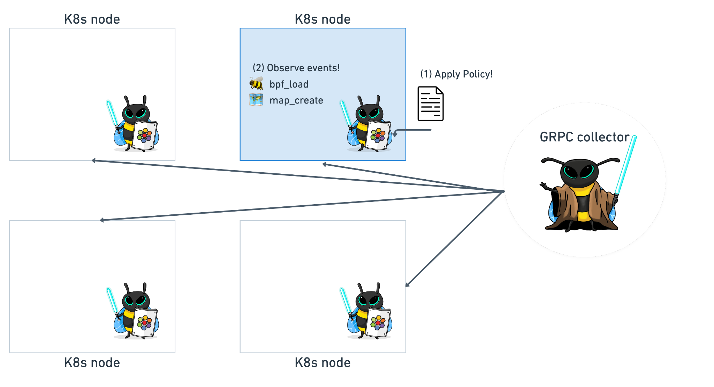
Introduce Test Environment
Workflow:
Apply Policy (bpf_check, security_perf_event_alloc security_bpf_map_alloc)
Observe events
Simple pod
Real World scenario - Cilium

Slide 30
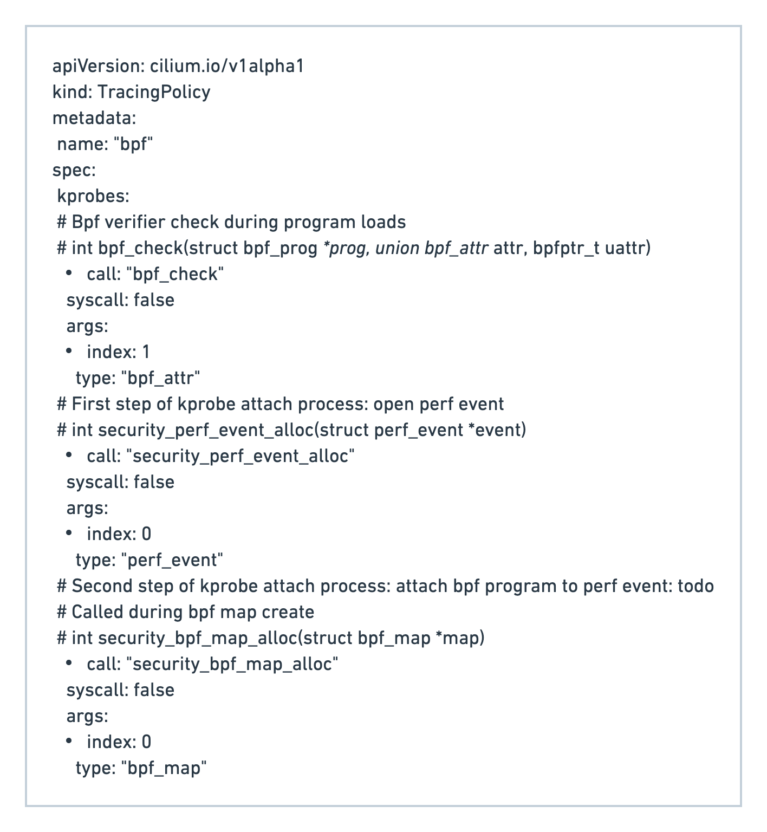
Security Policy - Audit BPF progs, maps
Functions:
bpf_check: when the Verifier checks the program before loading it
security_perf_event_alloc: creating a map to transfer events between userspace and kernel
security_bpf_map_alloc: creating a bpf map

Slide 31
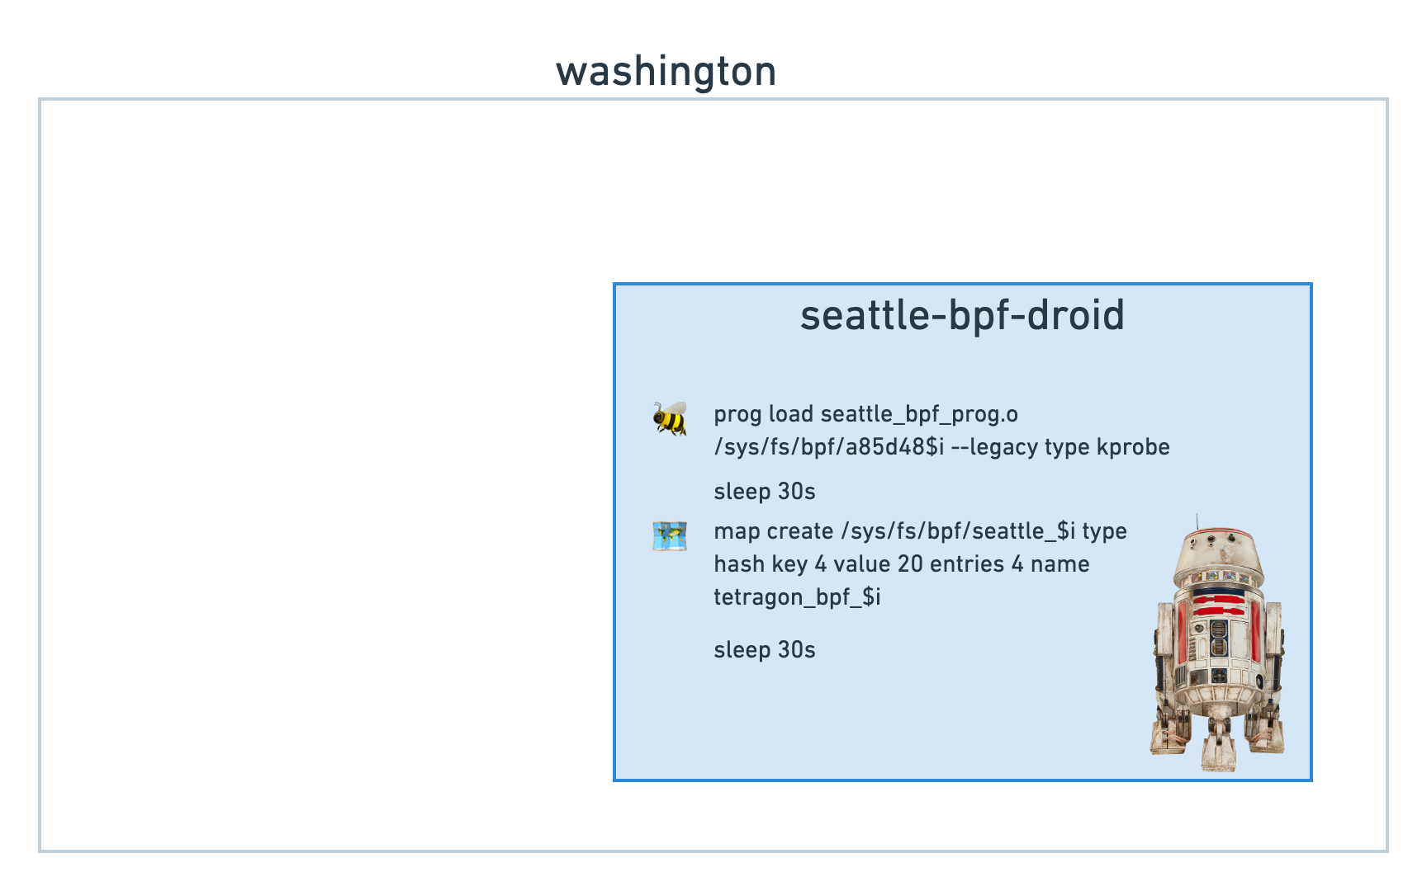
Simple pod - seattle-bpf-droid
seattle-bpf-droid
Load seattle_bpf_prog BPF program (kprobe)
Sleep 30s
Create tetragon_bpf hash map
Sleep 30s

Slide 32
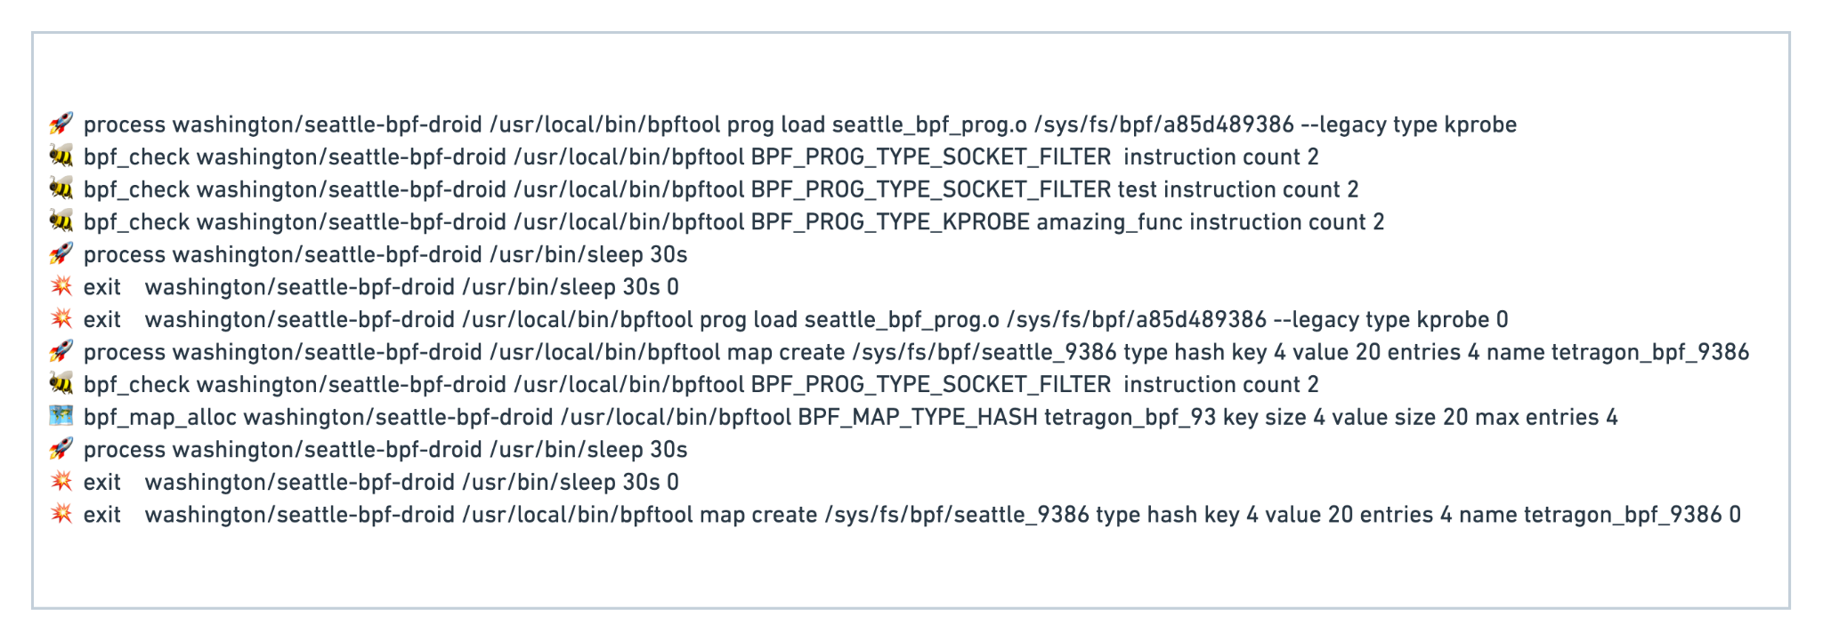
Simple pod - seattle-bpf-droid
Notes:
This is a screenshot But I will explain here how the events would look like.

Slide 33
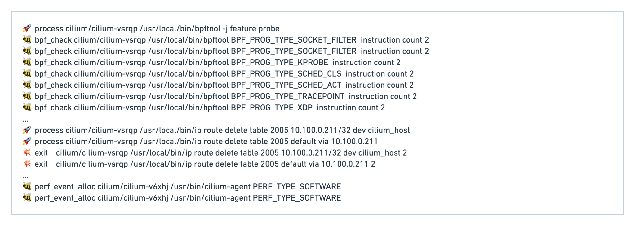

Real World Use Case - Cilium
Cilium:
Probe which features, maps are available at the kernel version
Check & remove IPtable rules
Init.sh: figure out which programs to load, which device to load them on
Compiling those programs
Notes:
Bpftool:
When cilium starts up, it needs to figure out what features are available at that kernel version, so it knows what to load.
Probing different features and maps.
Listing and removing IPtable rules
Init.sh: figuring out which programs to load, which device we should load them on
Clang: compiling the BPF programs
Perv_event_alloc: event map, transferring events between userspace and the kernel. So, the userspace agent can read from it.
E.g: Hubble observe

Slide 34
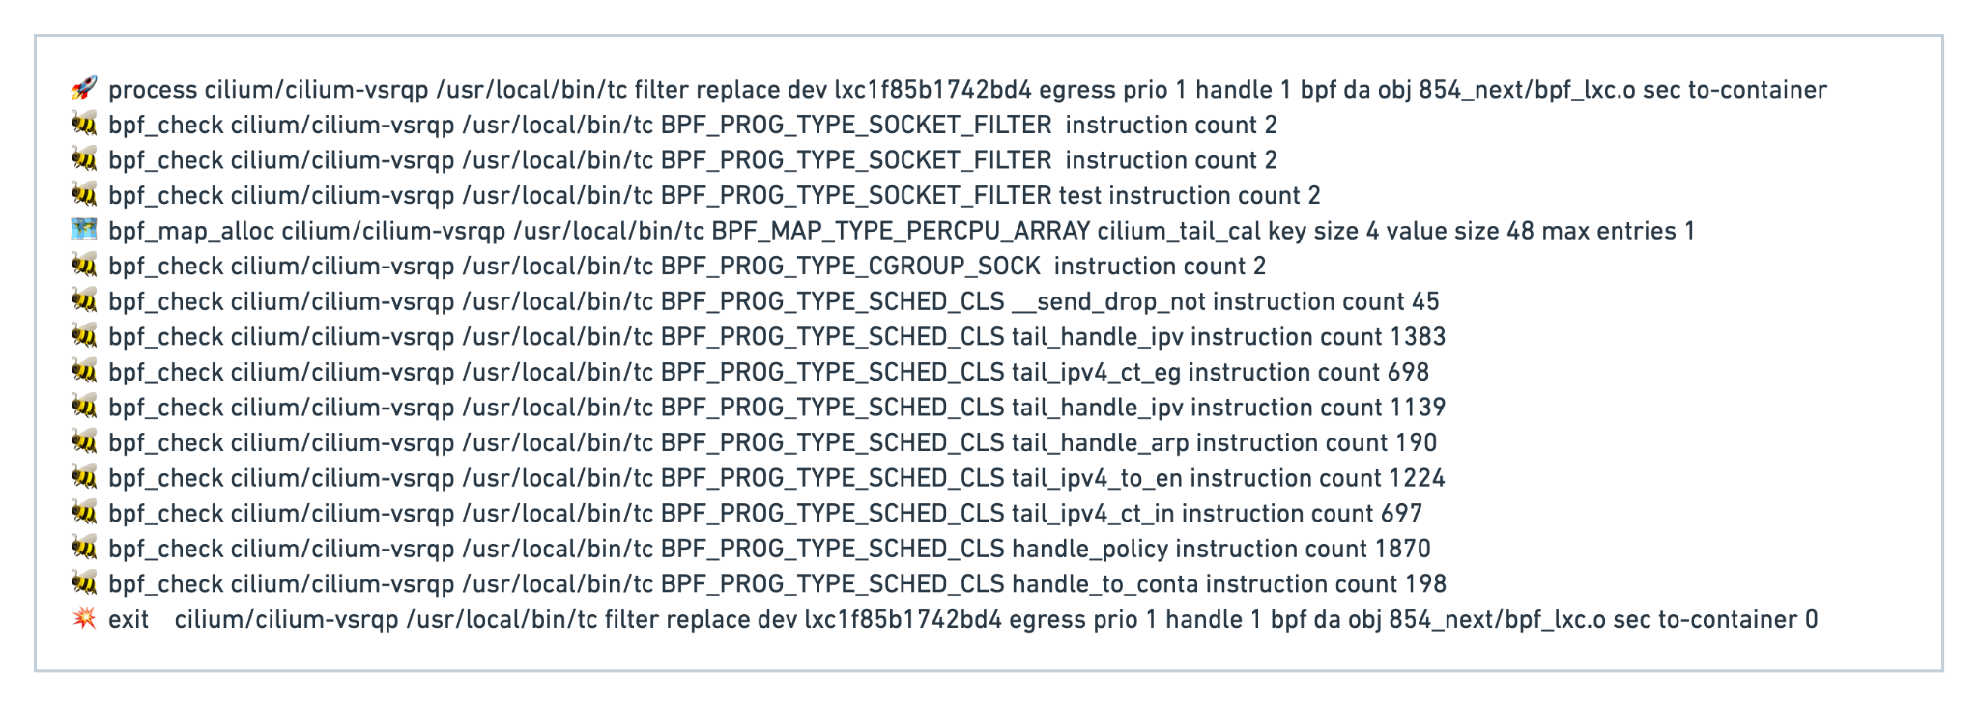
Real World Use Case - Cilium
Cilium:
5. Load BPF programs for each pod
Notes:
Tc: officially traffic control (configuration tool for Linux networking, routes, interfaces, devices)
This is how we load bpf program
Every pod on the node
Example:
Send_drop: notify the user agent when a packet was dropped
Policy_handle:
Tail calls

Slide 35
Wrapping up …
eBPF is on the rise
Networking, Observability, Security
Cross platform
Important to keep track & audit:
Who is watching eBPF? (programs, maps creation)
Auditing BPF programs with Tetragon
Demo
“Seattle-bpf-droid” test use case
Cilium startup

Slide 36
How to contribute?
github.com/cilium/tetragon
Use the tool: report bugs, create feature request, tell your user experience
Improve the documentation (open issues)
Add your use cases “./crds/examples”, “./contrib”
Tell us about how it doesn’t work for some use cases
Feedback on UI, CRDs, etc
Fix a bug, Implement a feature
Lots of work across all layers of the stack
Documentation, K8s, Golang, Systems Programming, BPF, Linux Kernel, Packaging

Slide 37
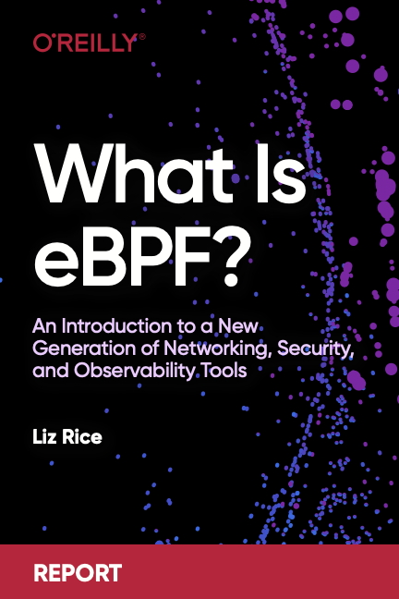
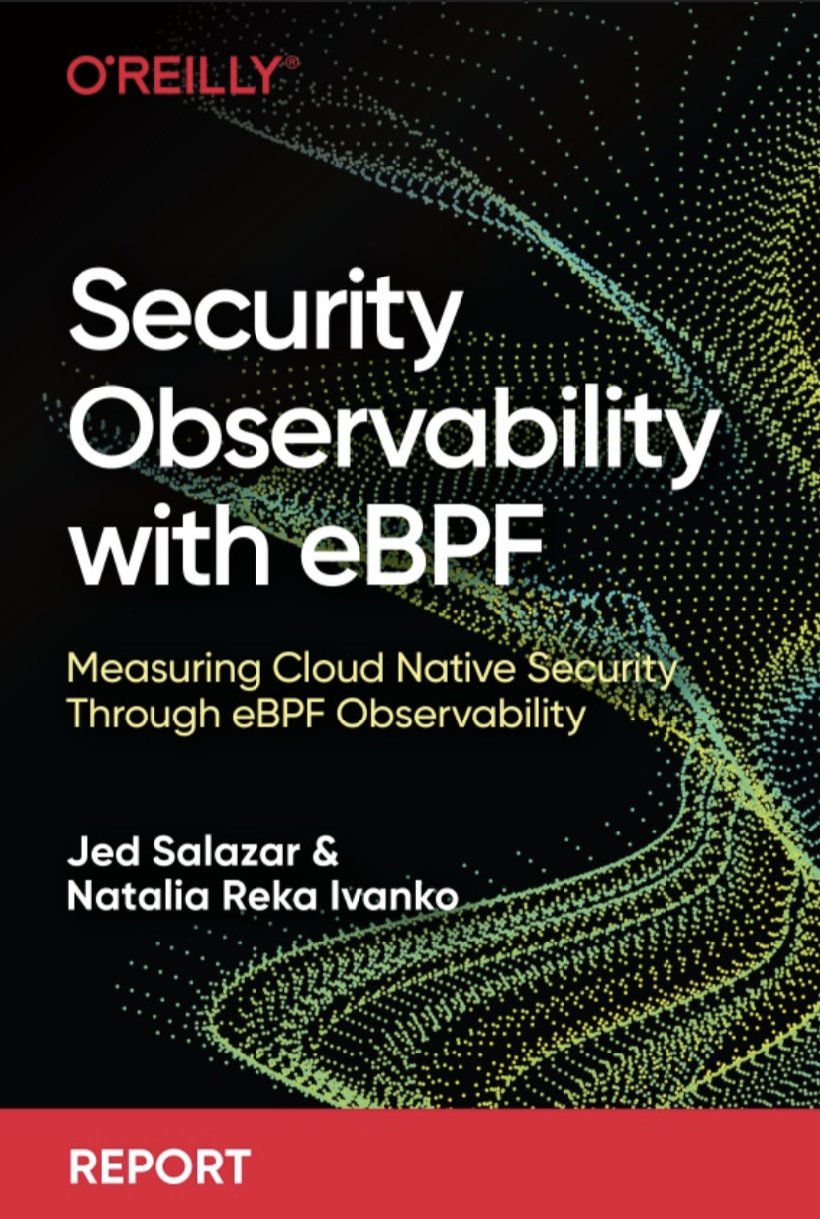




Thank you! Q&A
cilium/tetragon
@ciliumproject
cilium.io
@jrfastab
@sharlns

Slide 38

Please scan the QR code to leave feedback on this session

